Slide 1

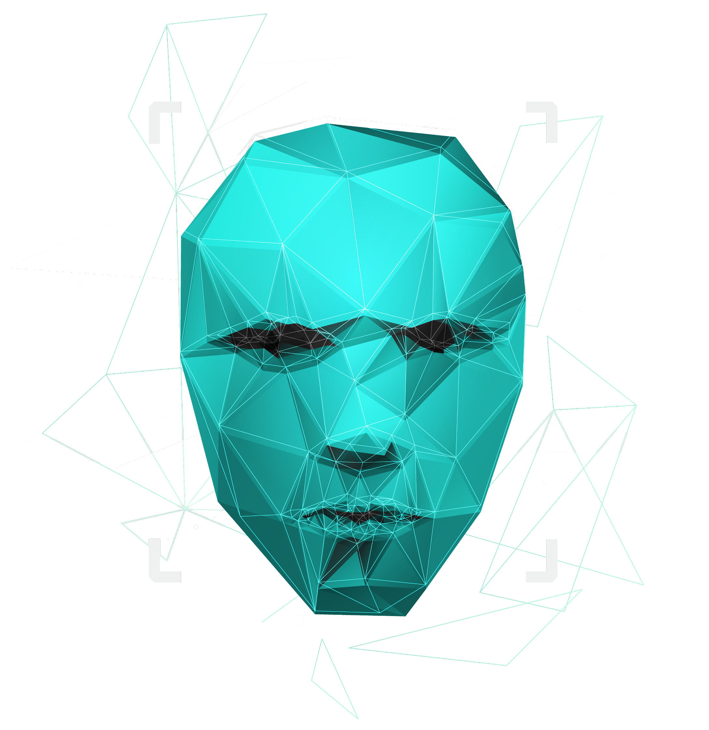
CARTOZI- CARTOONIFYING YOUR MEETS

Slide 2

TEAM MEMBERS
20BAI1319
DEVANSHU KHEMKA
SARVESH CHANDAK
20BAI1221
20BAI1048
HARDIK KATHURIA

Slide 3
PROJECT REFLECTION
PRESNT METHODOLOGIES
01
03
VIRTUAL MEETS
PROPOSED METHODOLOGY
02
04

Slide 4

PROJECT REFLECTION
One of the really nice things we can do with new technology is having fun. So one of the incredibly enjoyable so simple things to do is to make a cartoon of yourself.

Slide 5
PRESENT METHODOLOGIES
Convert photo into cartoon with Photoshop
Convert photo to cartoon using Adobe illustrator
Cartoon a Picture Online on Toonyphotos.com
Using Neural Netwrok
Convert photo to cartoon with Paint.net

Slide 6
Virtual Meets
01

Slide 7
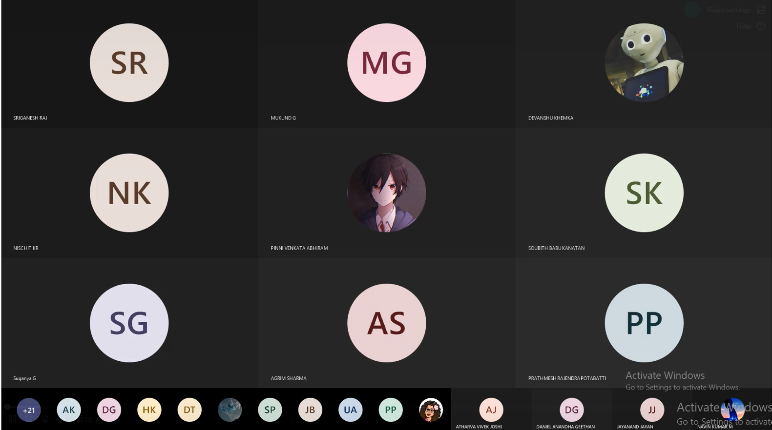
Present Virtual Meets
Mercury is the smallest planet in our Solar System
Venus has a beautiful name, but it’s terribly hot
Jupiter is the biggest planet in our Solar System
Saturn is composed of hydrogen and helium

Slide 8










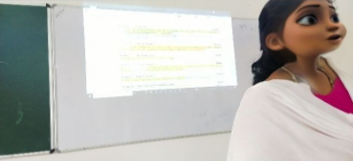









Cartozi Virtual Meets
Mercury is the smallest planet in our Solar System
Venus has a beautiful name, but it’s terribly hot
Jupiter is the biggest planet in our Solar System
Saturn is composed of hydrogen and helium

Slide 9
HOW DO WE DO IT?
We have used CNN (Convolution Neural Network)
A Convolutional neural network (CNN) is a type of artificial neural network used in image recognition and processing that is specifically designed to process pixel data.
CNNs are powerful image processing, artificial intelligence (AI) that use deep learning to perform both generative and descriptive tasks, often using machine vison that includes image and video recognition, along with recommender systems and natural language processing (NLP).

Slide 10
BENEFITS
No need to flatten the input images to 1D as they are capable of working with image data in 2D
reducing the number of parameters without losing on the quality of models
It automatically detects the important features without any human supervision.
perfect when orthology
matters or if you are
working with characters
such as emojis or byte.

Slide 11

THANKS!
Do you have any questions?
Devanshu.khemka2020@vitstudent.ac.in
+91 7693891442
Group-2
Please keep this slide for attribution.

Slide 12
RESOURCES
VECTOR
https://www.google.com/search?q=advantages+of+using+CNN+for+image+recognization+over+others&rlz=1C1GGRV_enIN925IN926&oq=advantages+of+using+CNN+for+image+recognization+over+others&aqs=chrome..69i57j33i10i160l4.13783j0j7&sourceid=chrome&ie=UTF-8Artificial face recognition abstract technology
https://www.techtarget.com/searchenterpriseai/definition/convolutional-neural-network#:~:text=A%20convolutional%20neural%20network%20(CNN,designed%20to%20process%20pixel%20data.
https://ijisrt.com/wp-content/uploads/2019/04/IJISRT19MA311.pdf
Others mentioned there in the documentation…

